Slide 1
WIX3001 Soft Computing Lecture 1: Introduction to Neural Networks
Dr. Liew Wei Shiung
FSKTM B-2-22
liew.wei.shiung.phd@um.edu.my
Attendance: https://bit.ly/3Jr5sYu

Slide 2
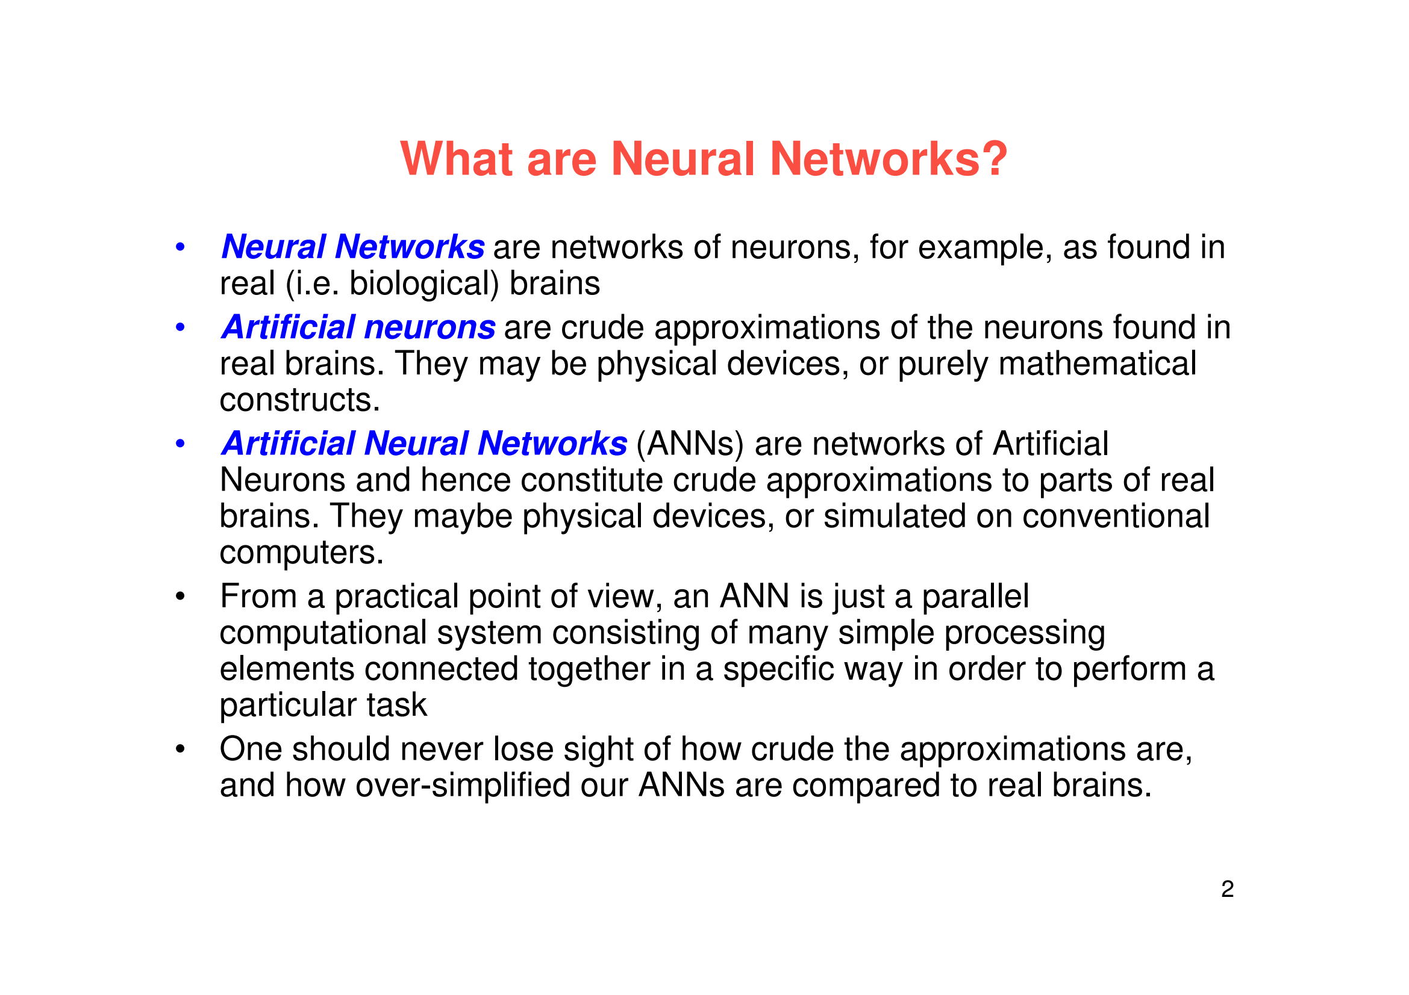
Attendance: https://bit.ly/3Jr5sYu

Slide 3
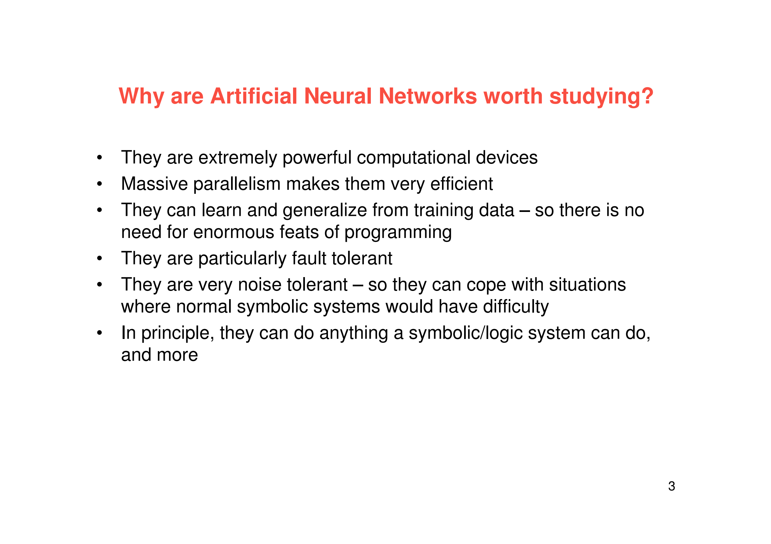
Attendance: https://bit.ly/3Jr5sYu

Slide 4
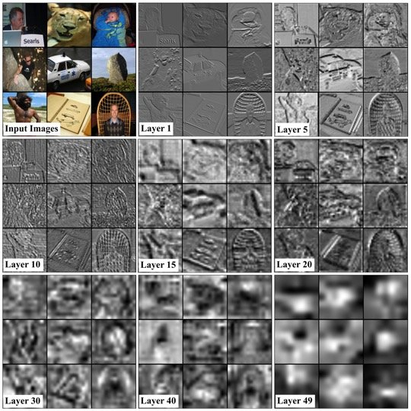
Attendance: https://bit.ly/3Jr5sYu

Slide 5
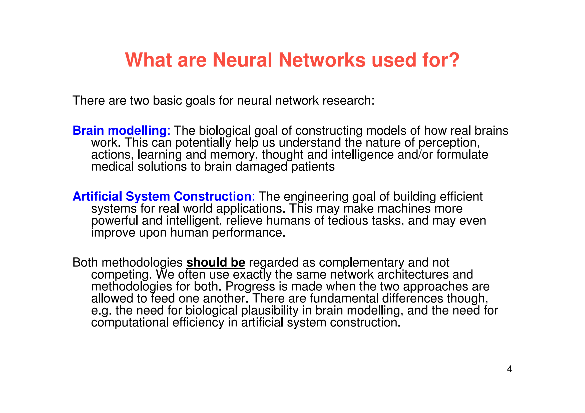
Attendance: https://bit.ly/3Jr5sYu

Slide 6
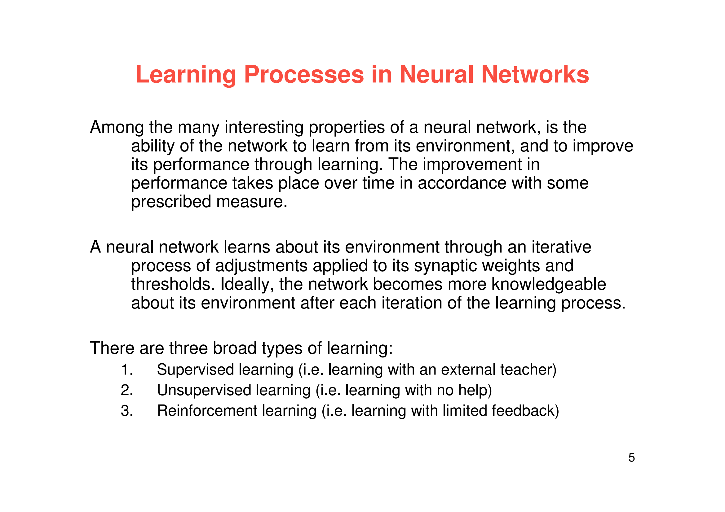
Attendance: https://bit.ly/3Jr5sYu

Slide 7
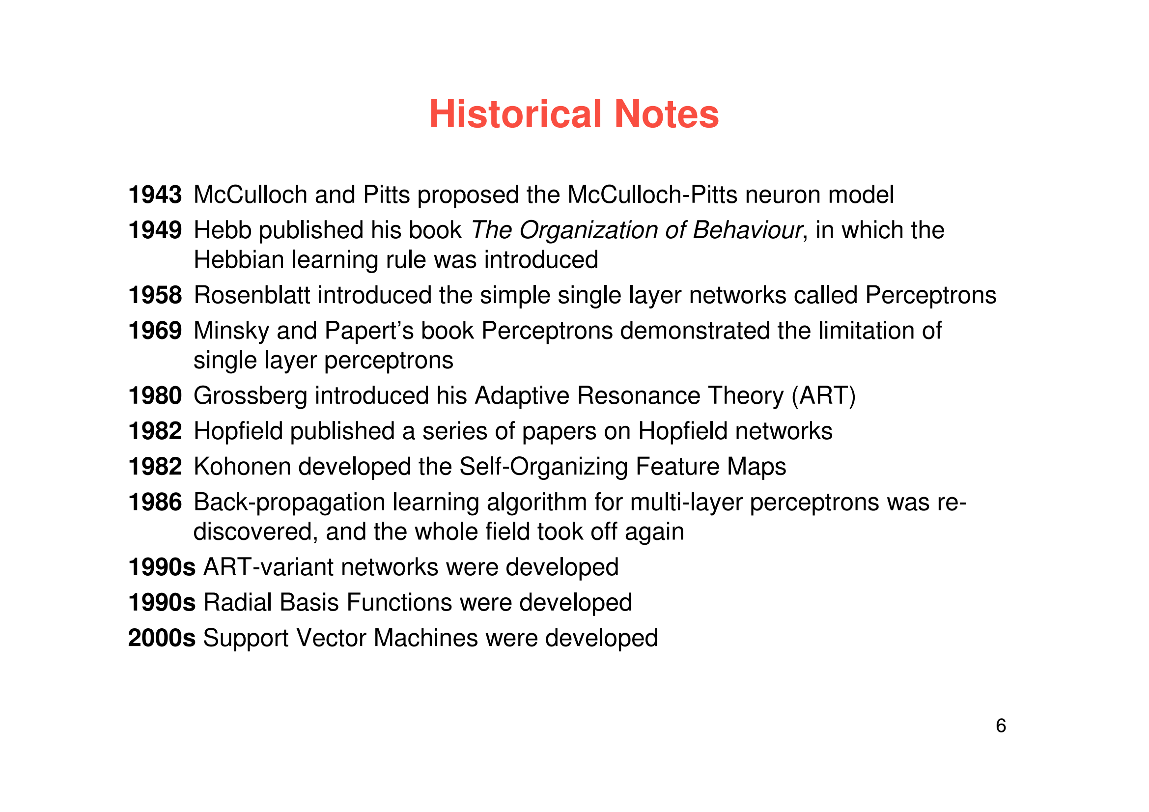
Attendance: https://bit.ly/3Jr5sYu

Slide 8
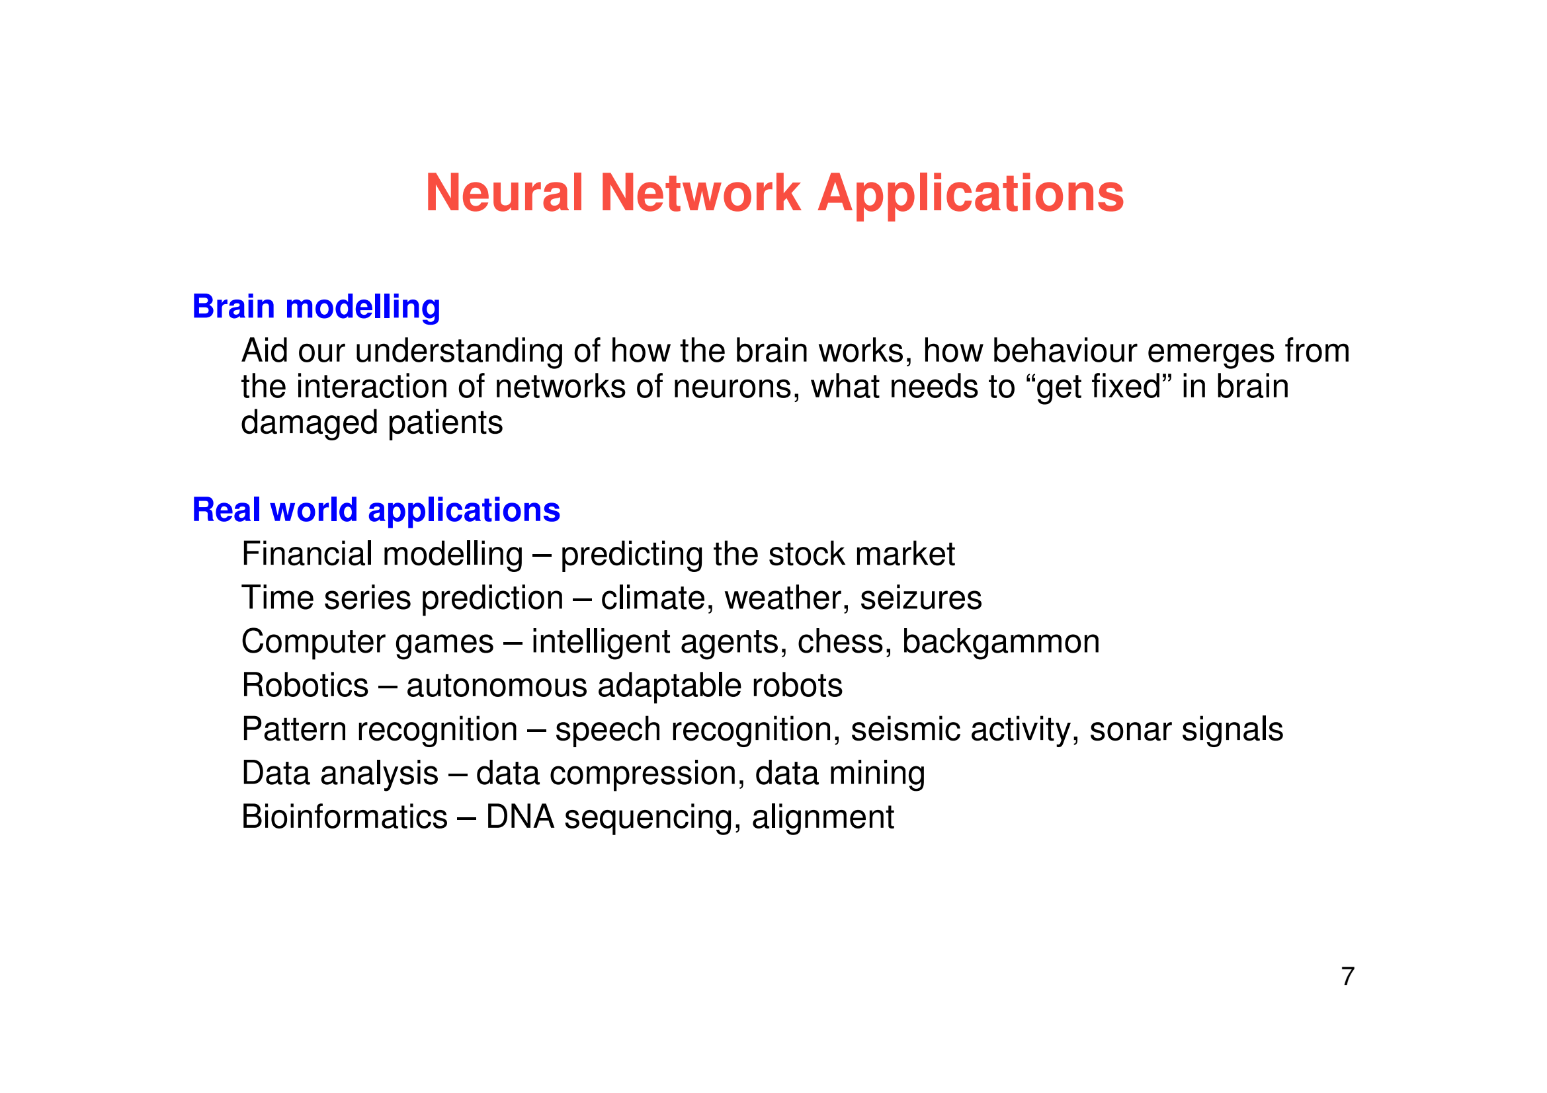
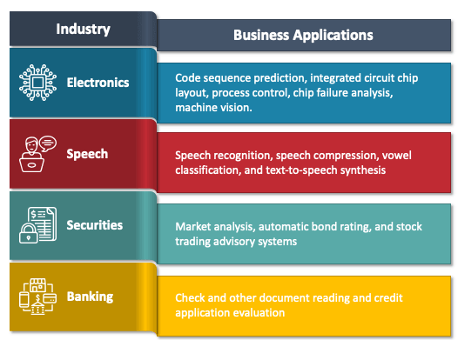
Attendance: https://bit.ly/3Jr5sYu

Slide 9
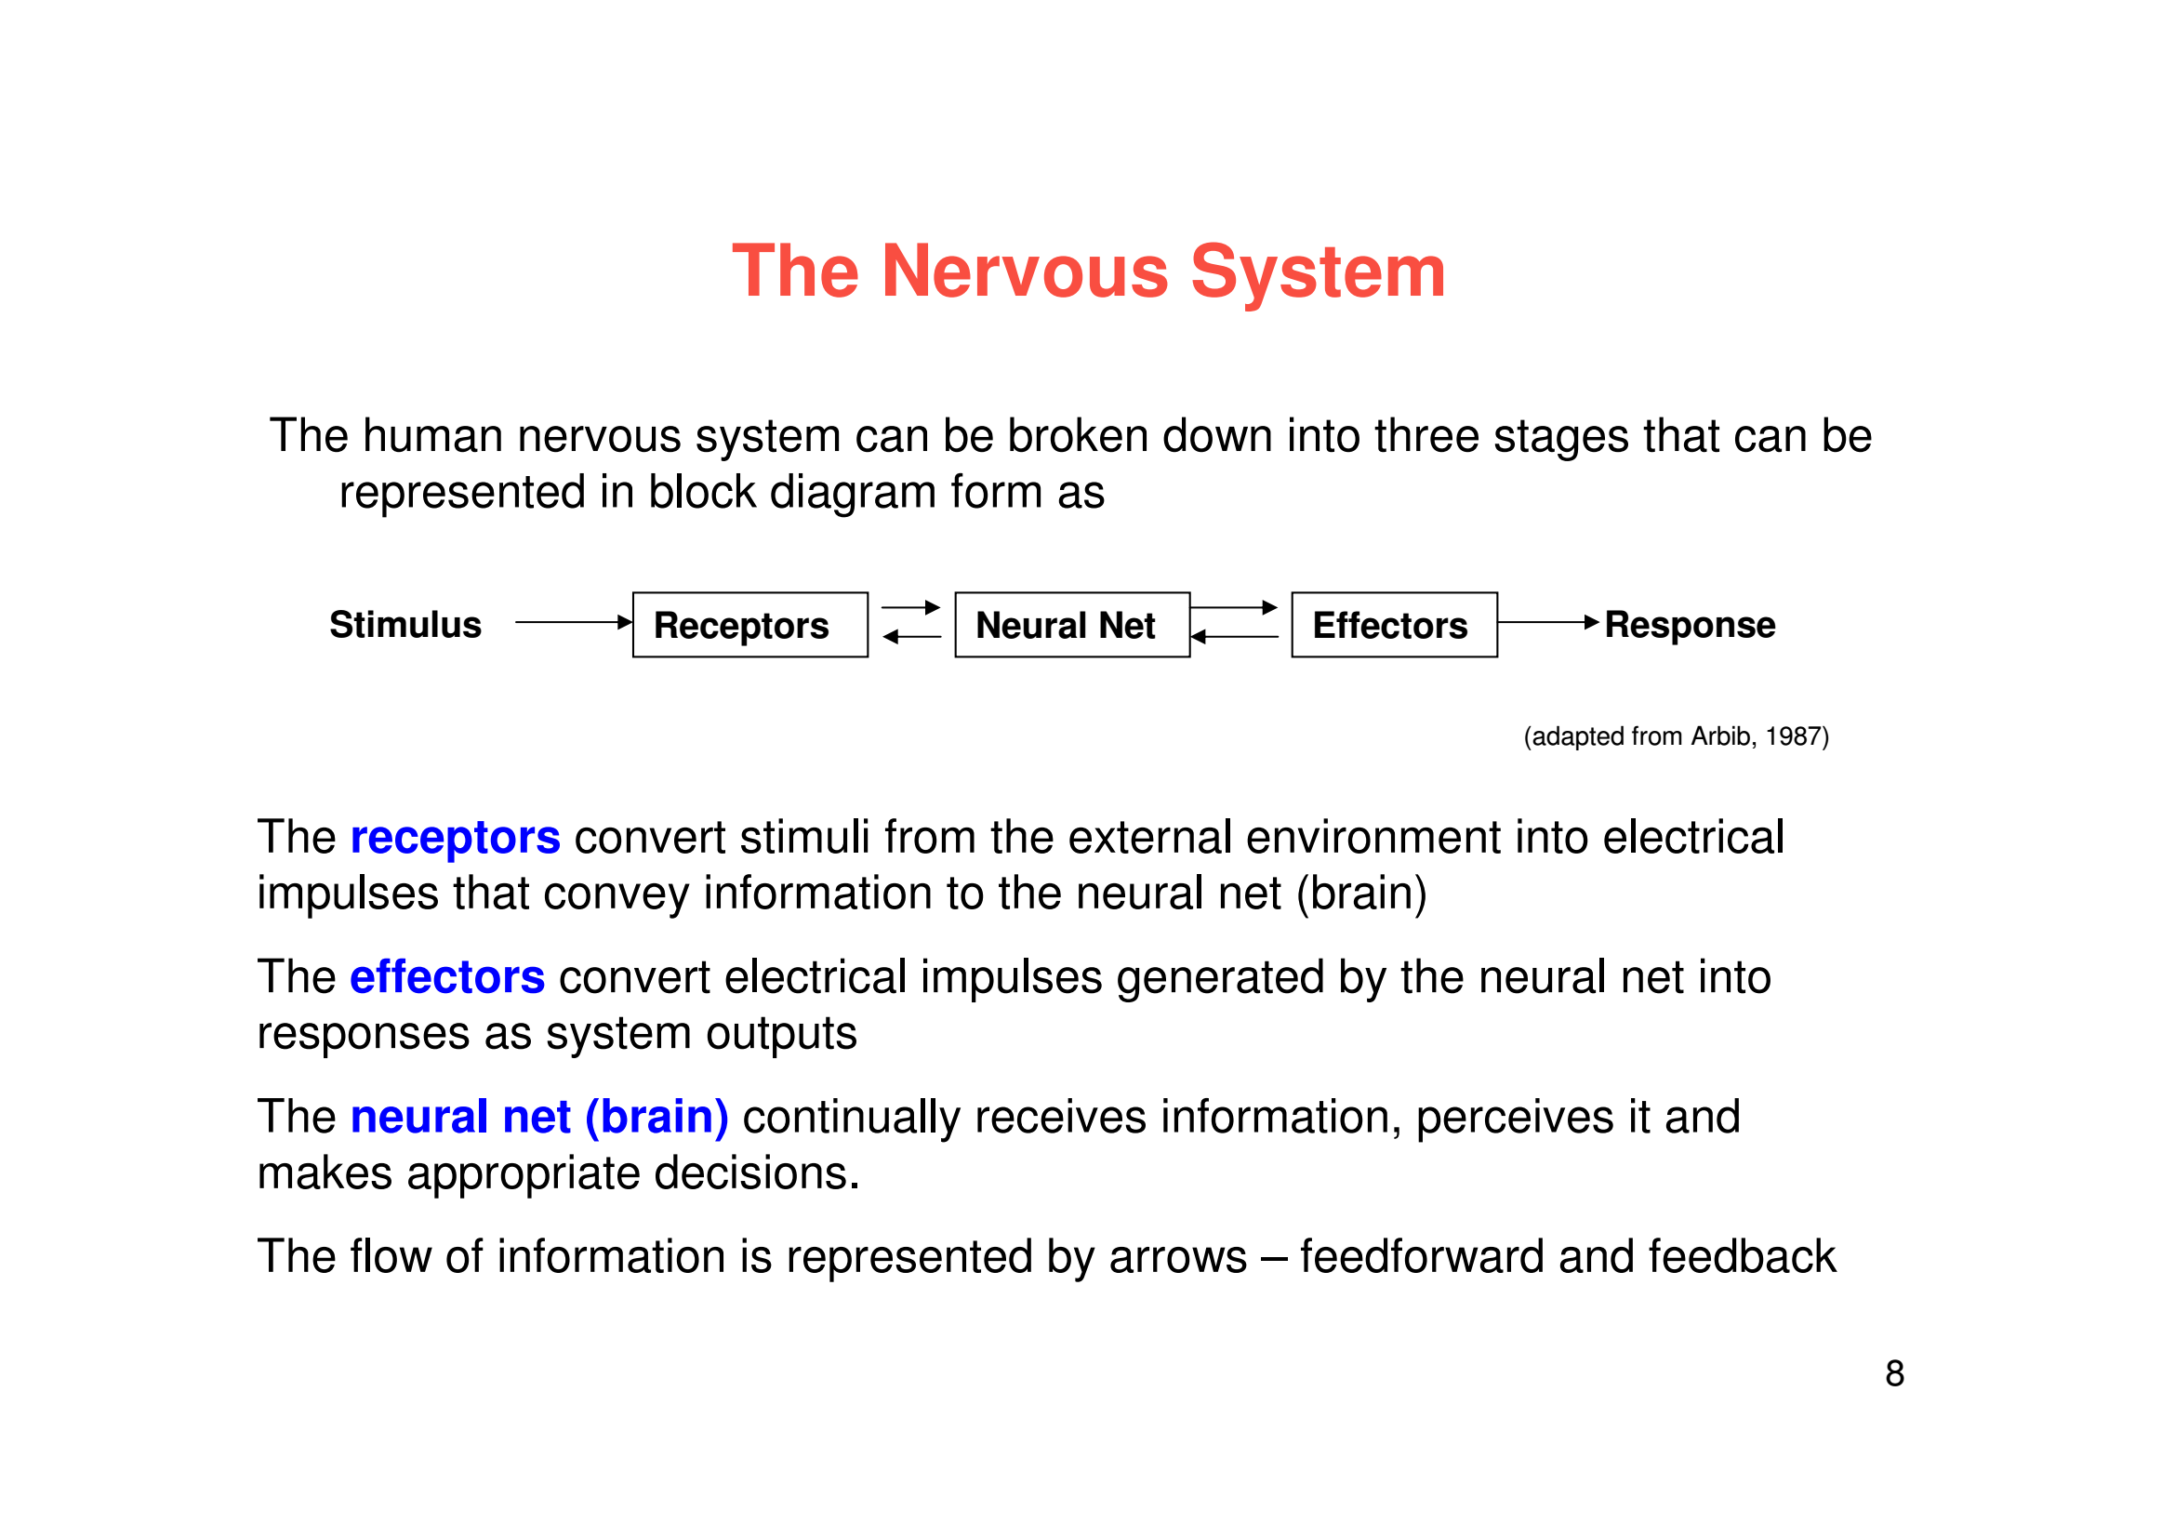
Attendance: https://bit.ly/3Jr5sYu

Slide 10
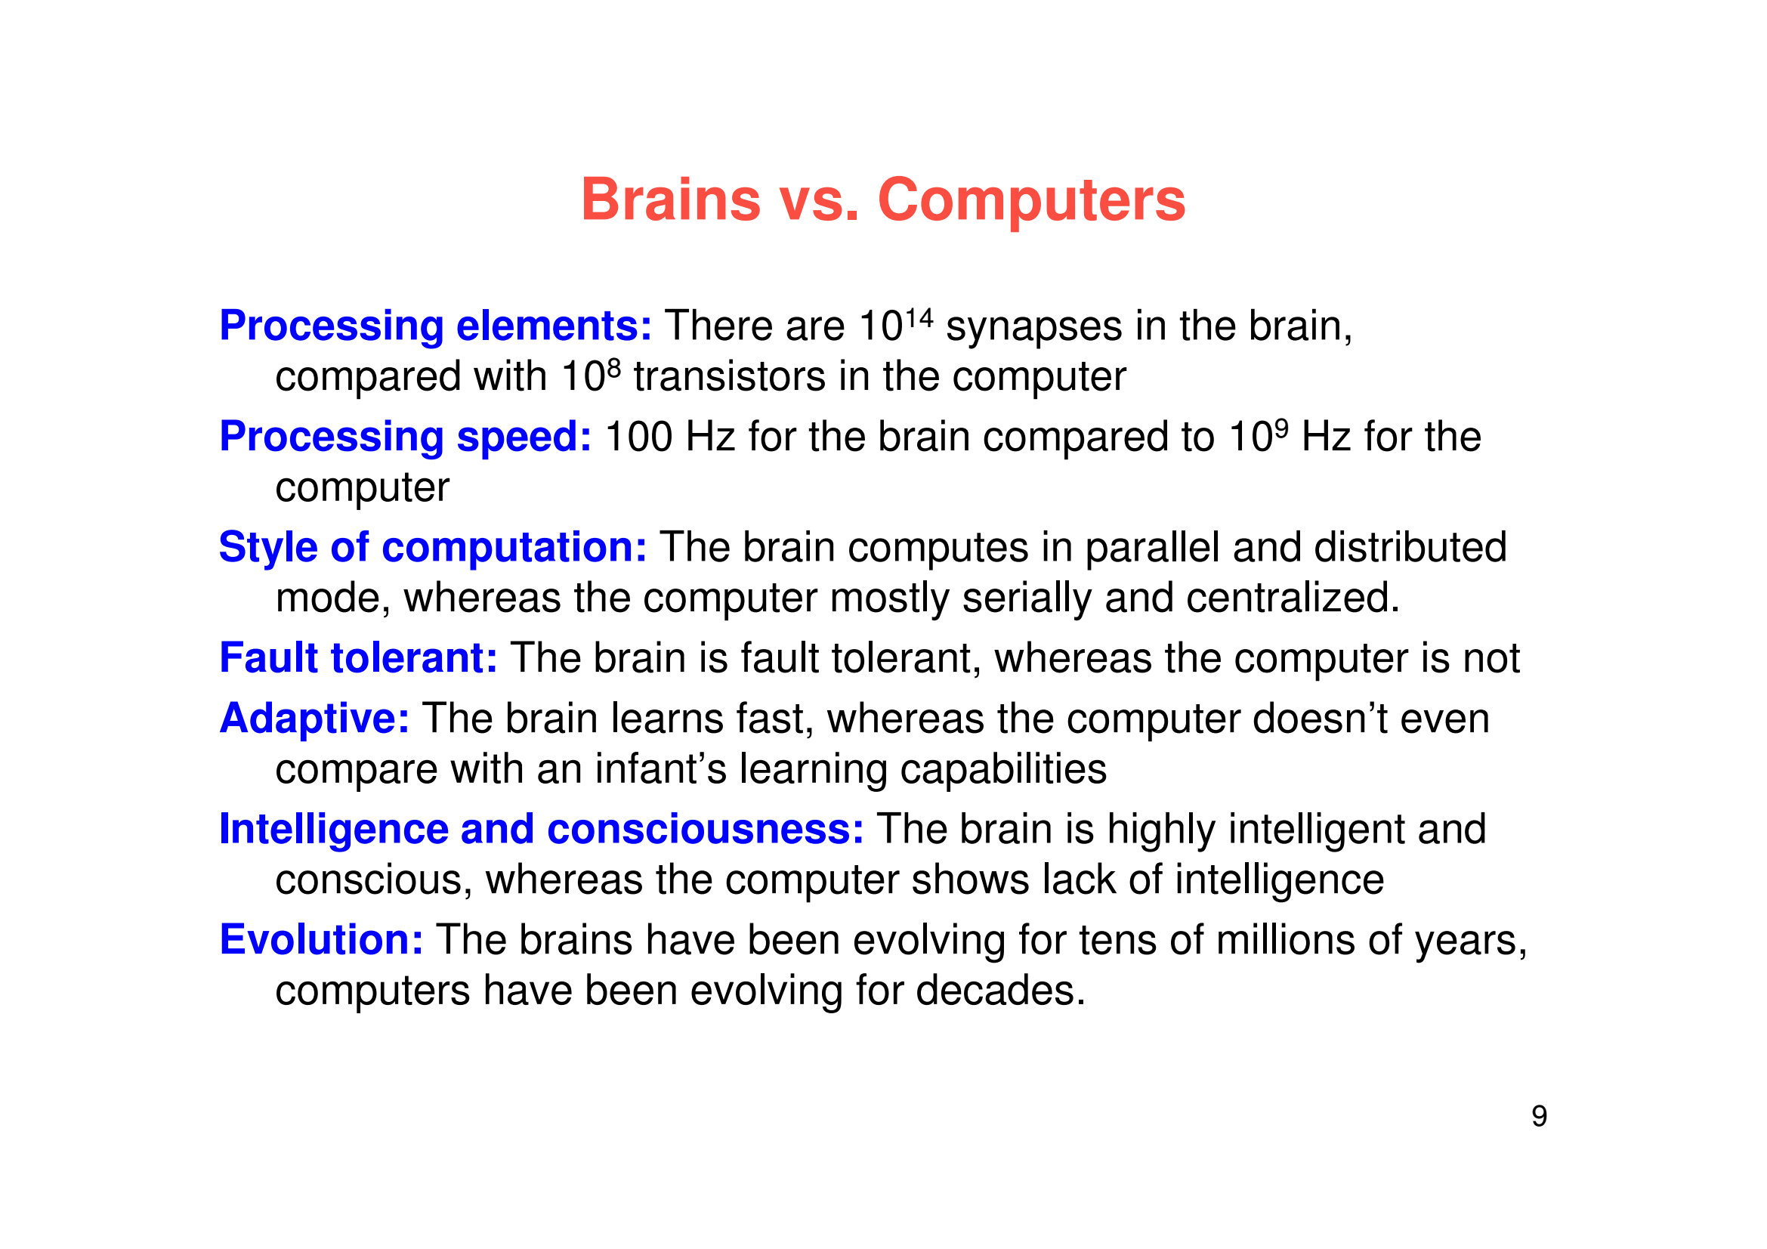
Attendance: https://bit.ly/3Jr5sYu

Slide 11
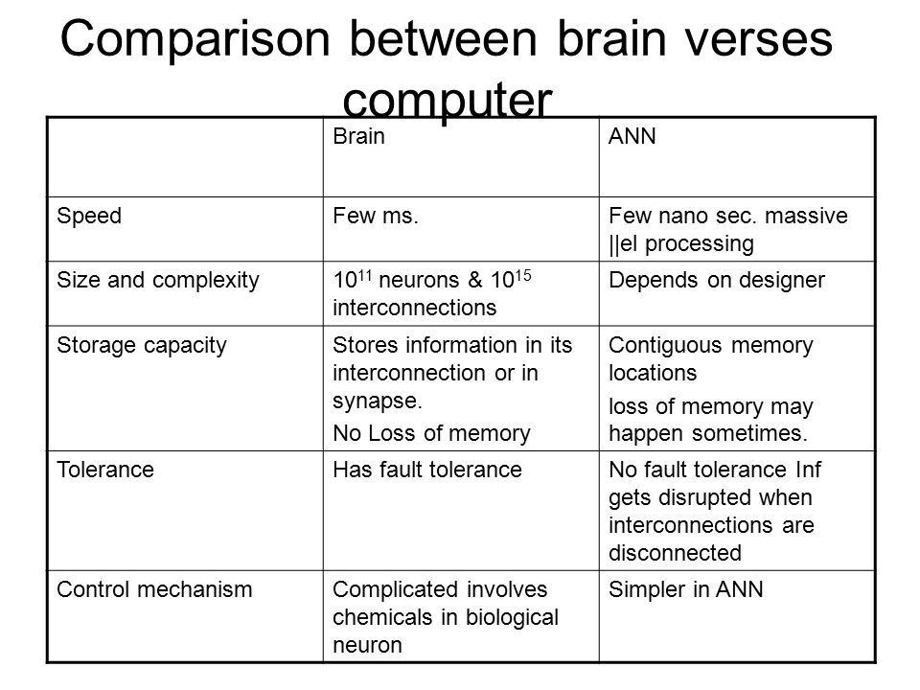
Attendance: https://bit.ly/3Jr5sYu

Slide 12
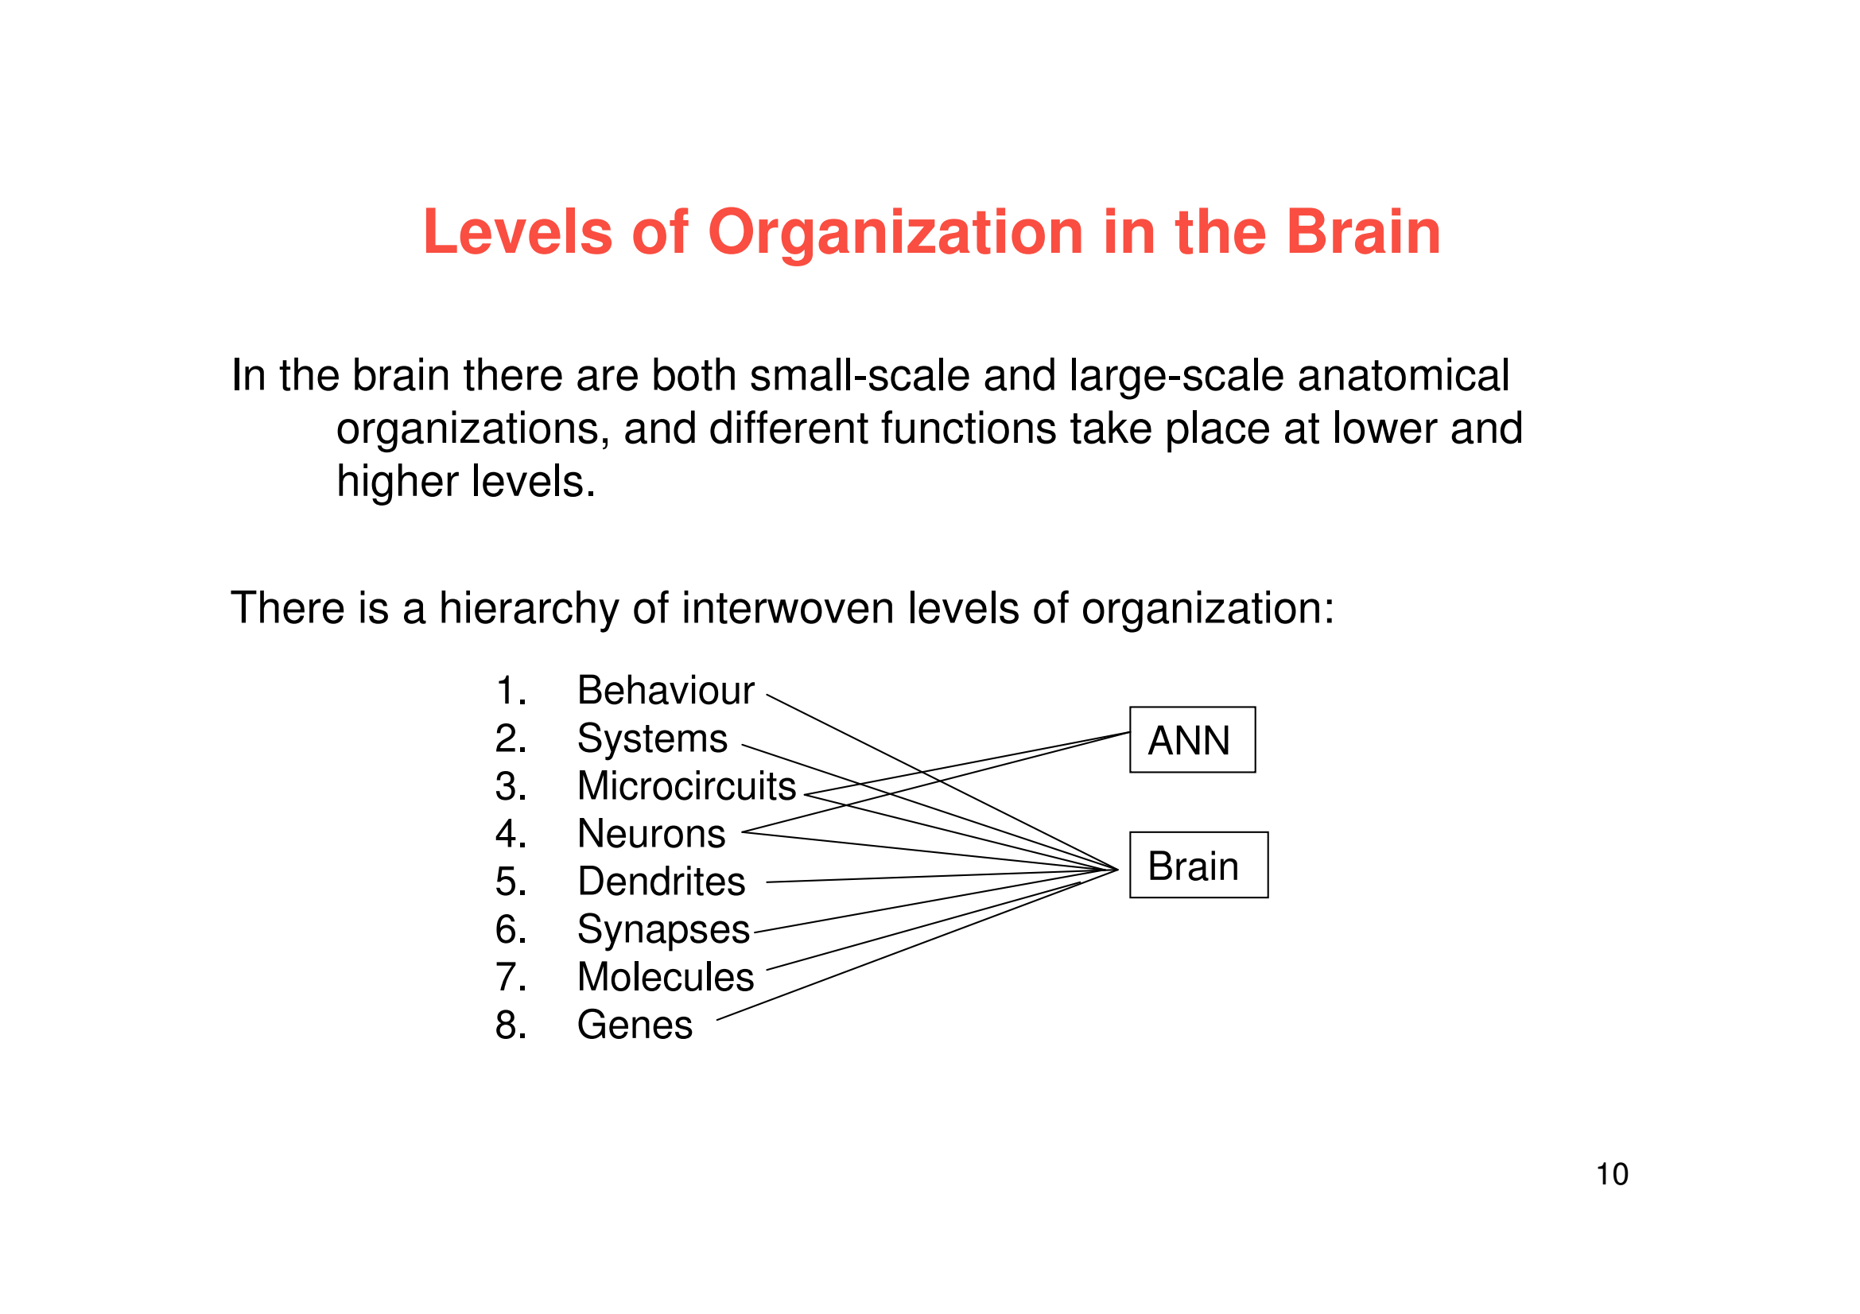
Attendance: https://bit.ly/3Jr5sYu

Slide 13
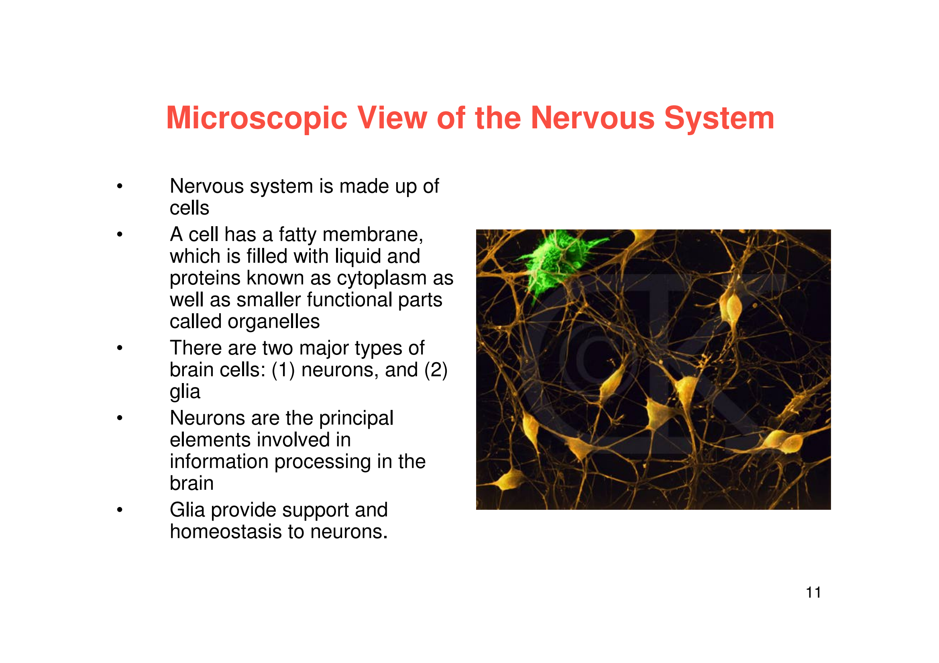
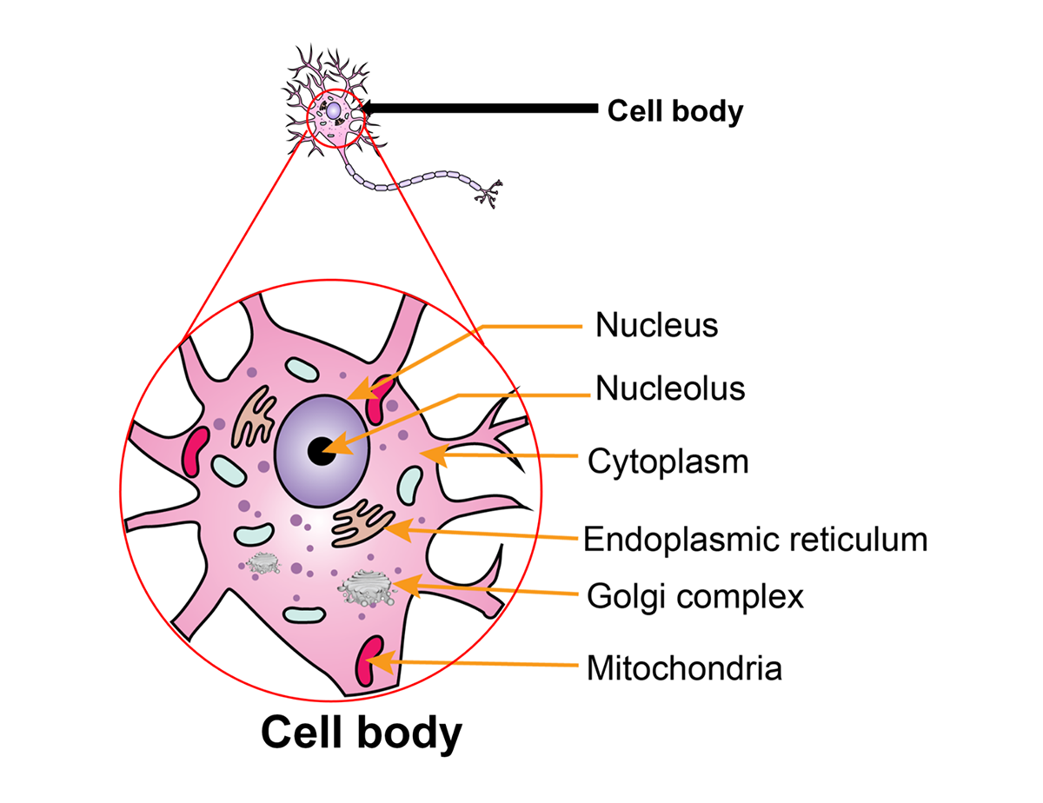
Attendance: https://bit.ly/3Jr5sYu

Slide 14
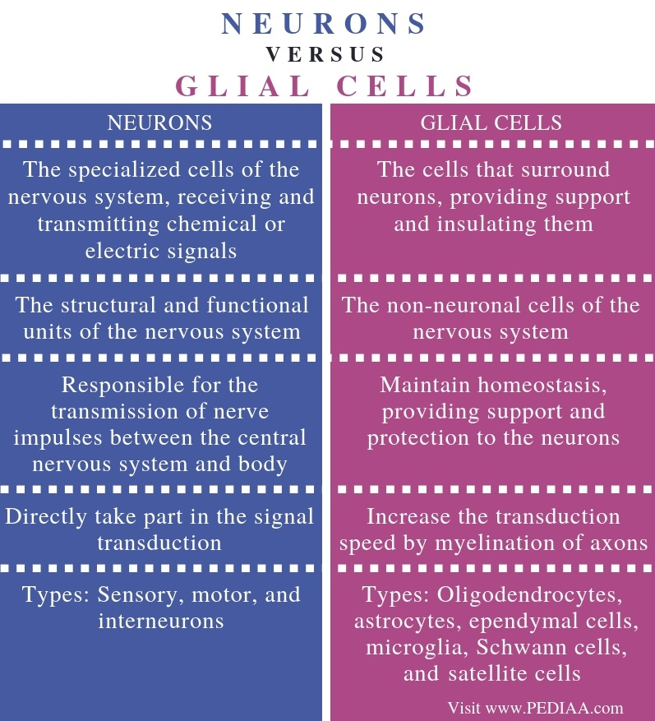
Attendance: https://bit.ly/3Jr5sYu

Slide 15
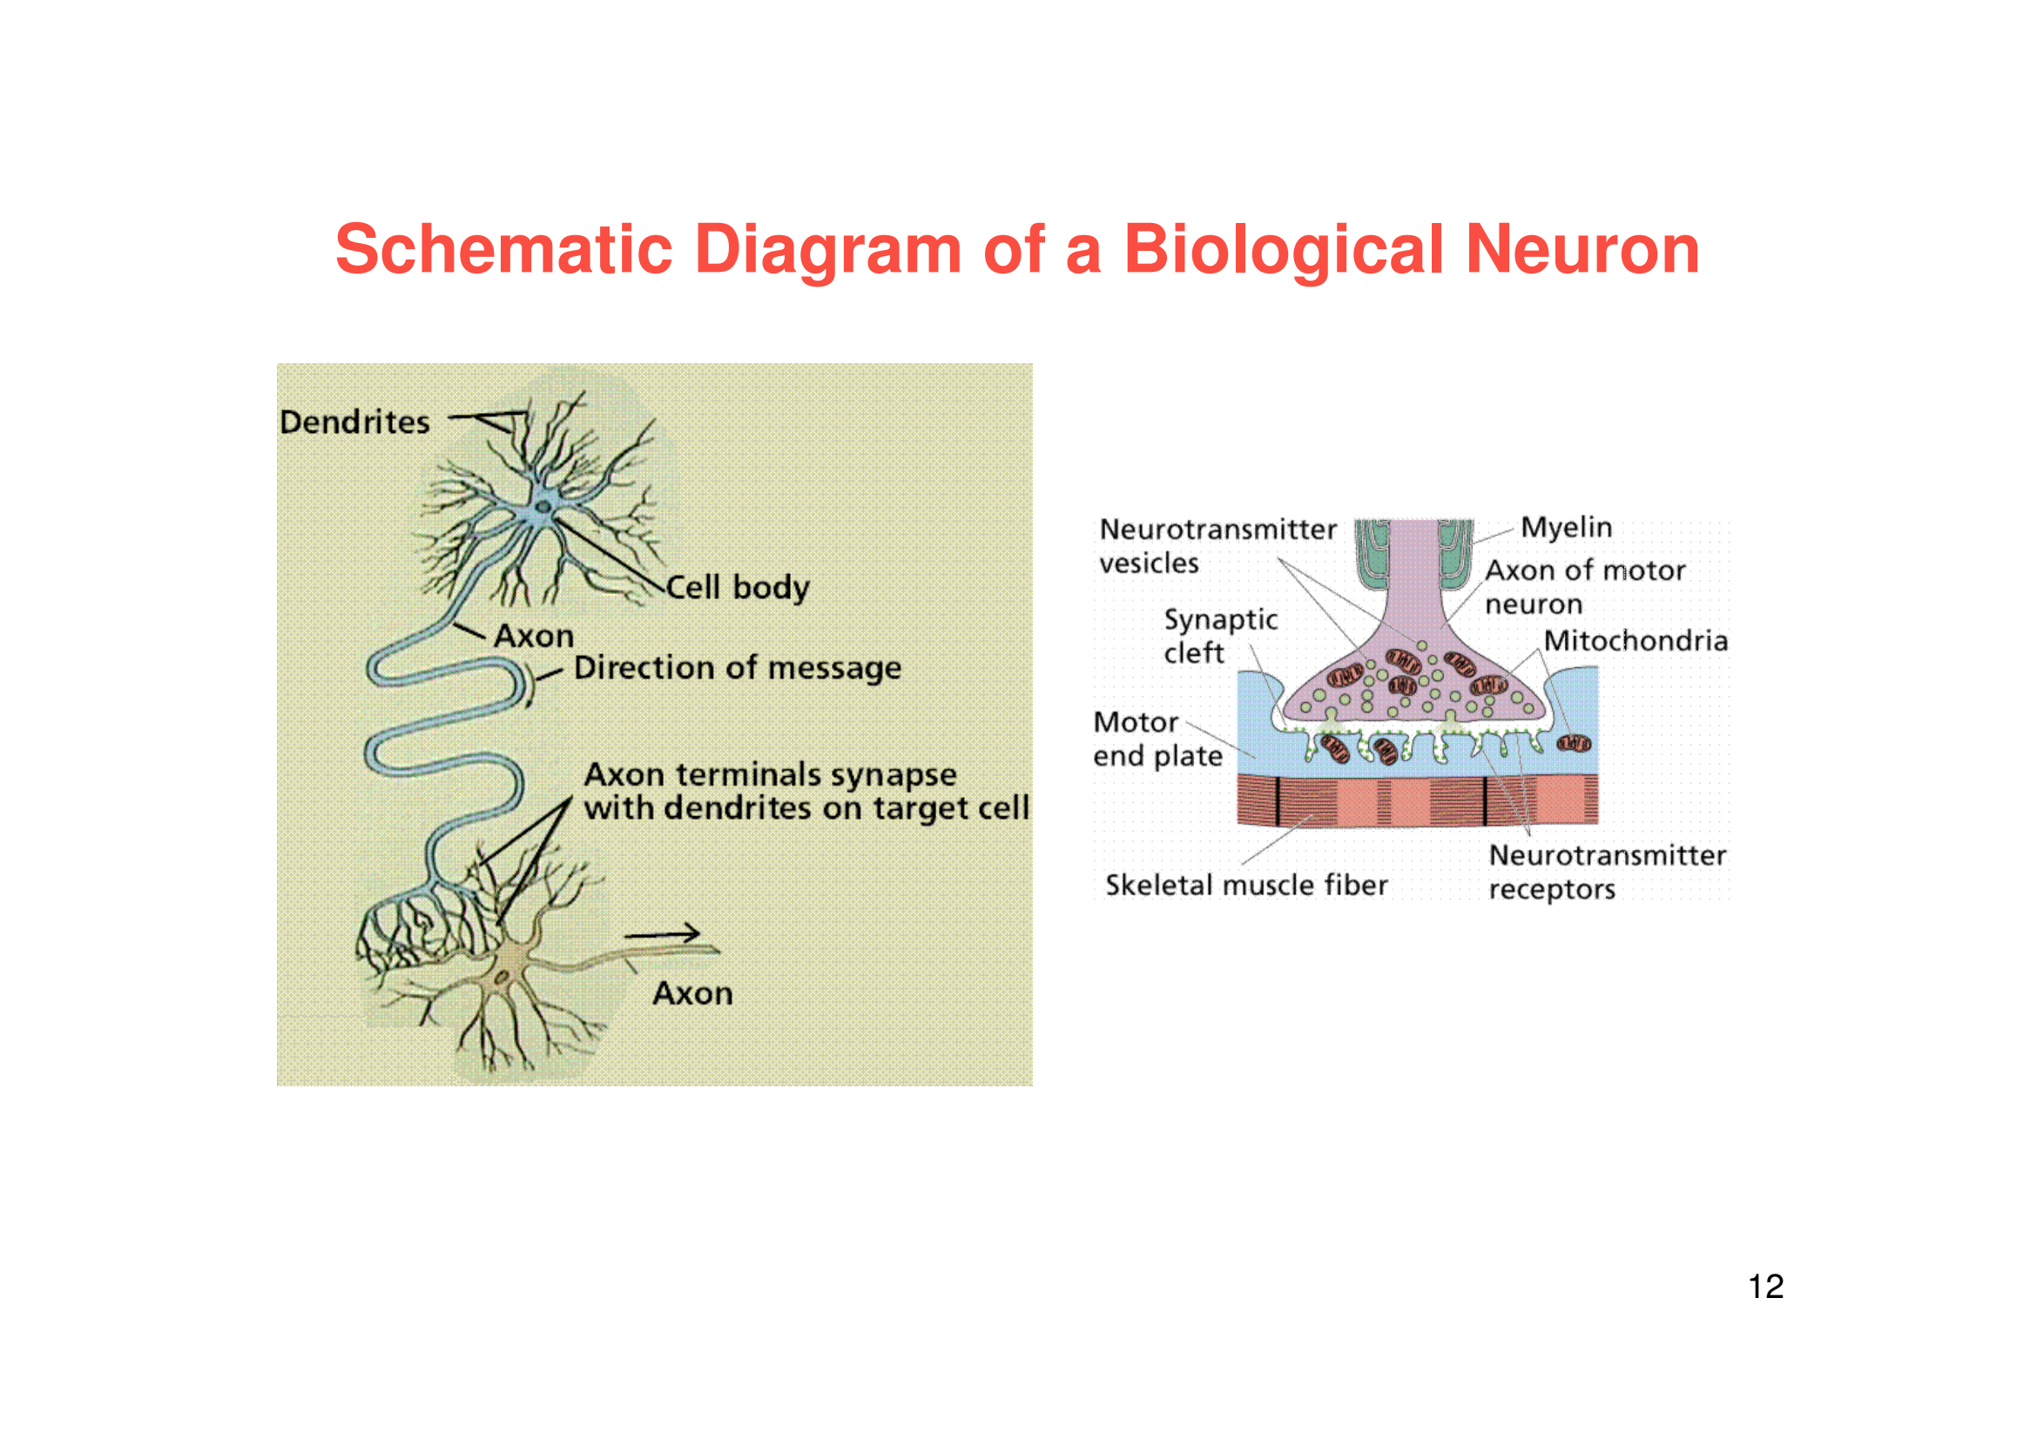
Attendance: https://bit.ly/3Jr5sYu

Slide 16
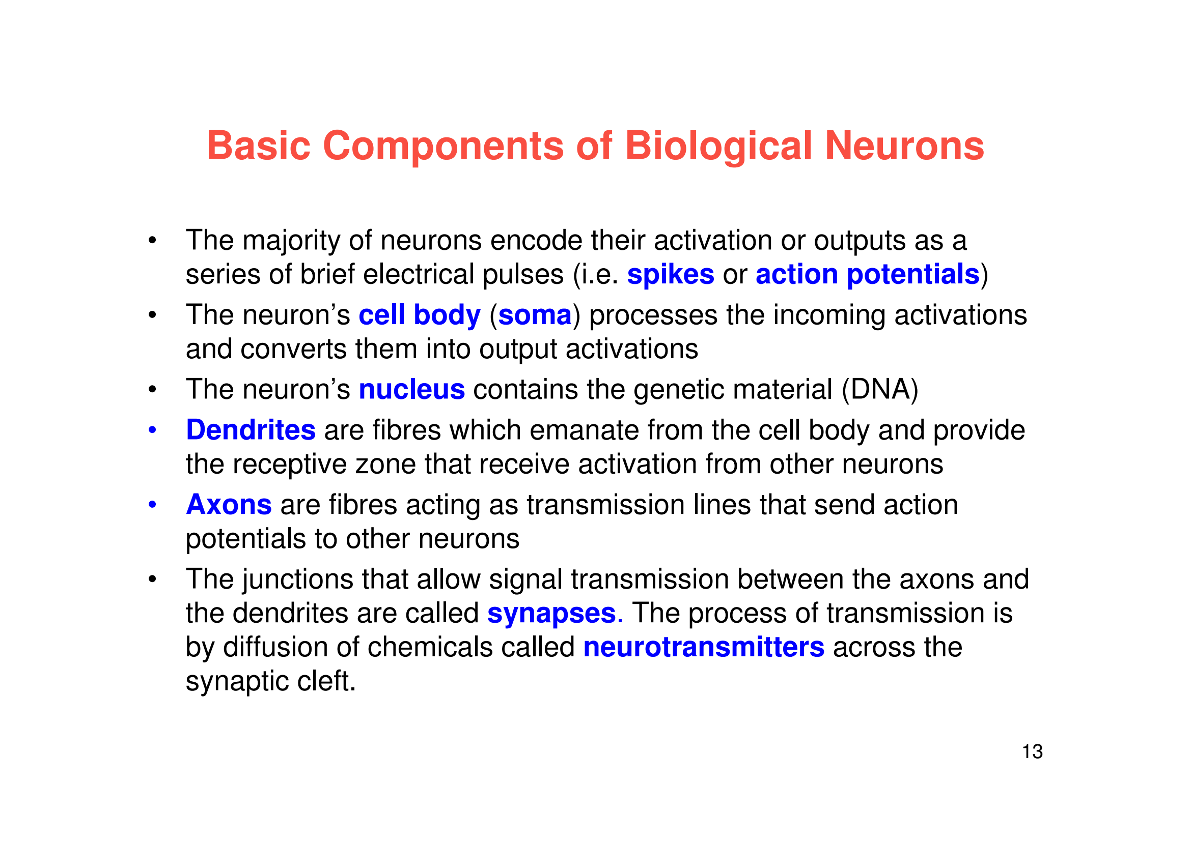
Attendance: https://bit.ly/3Jr5sYu

Slide 17
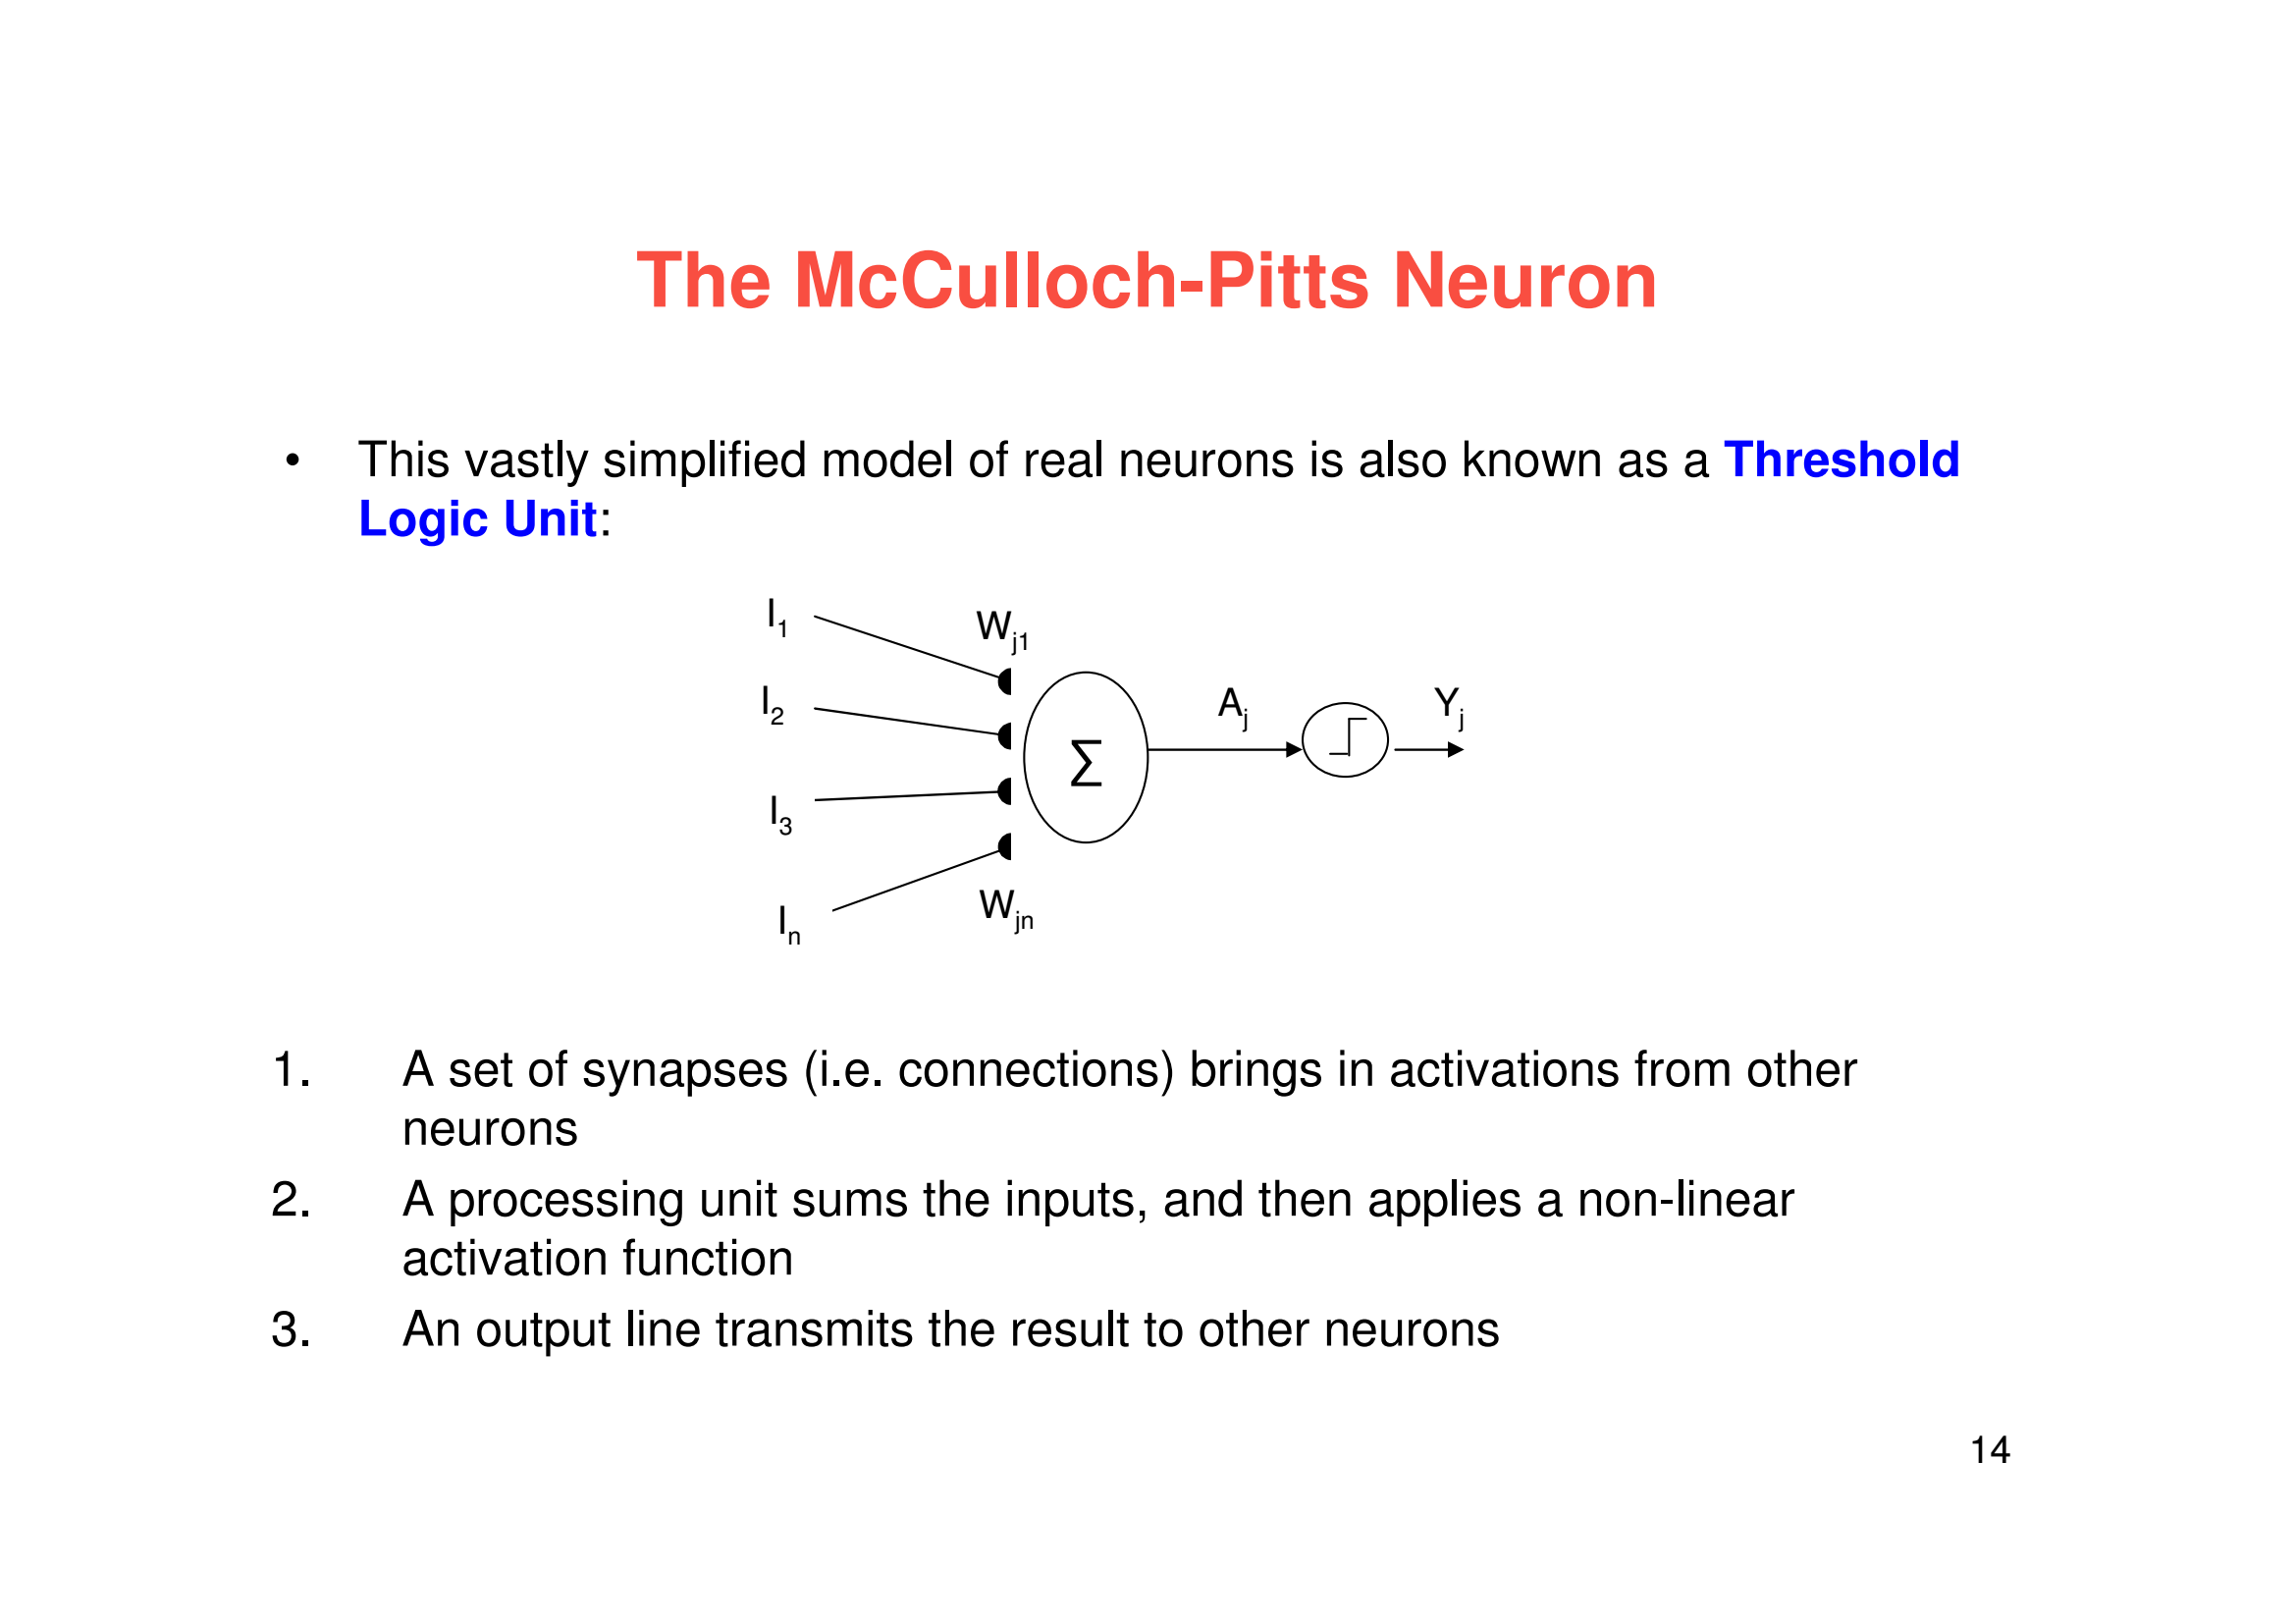
Attendance: https://bit.ly/3Jr5sYu

Slide 18
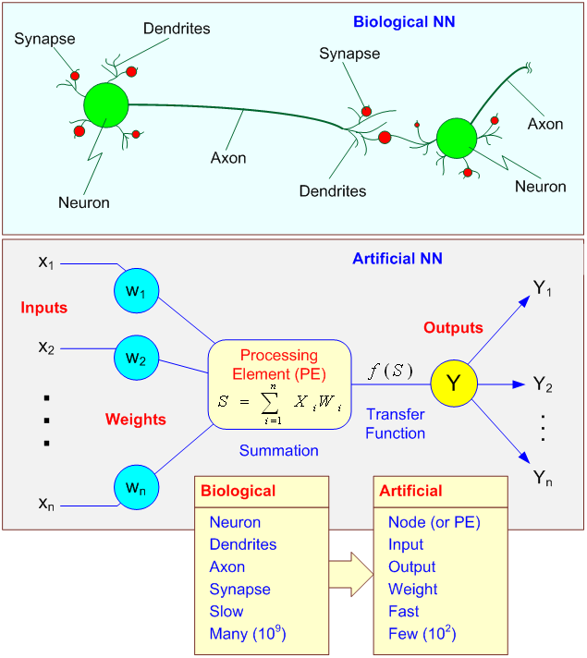
Attendance: https://bit.ly/3Jr5sYu

Slide 19
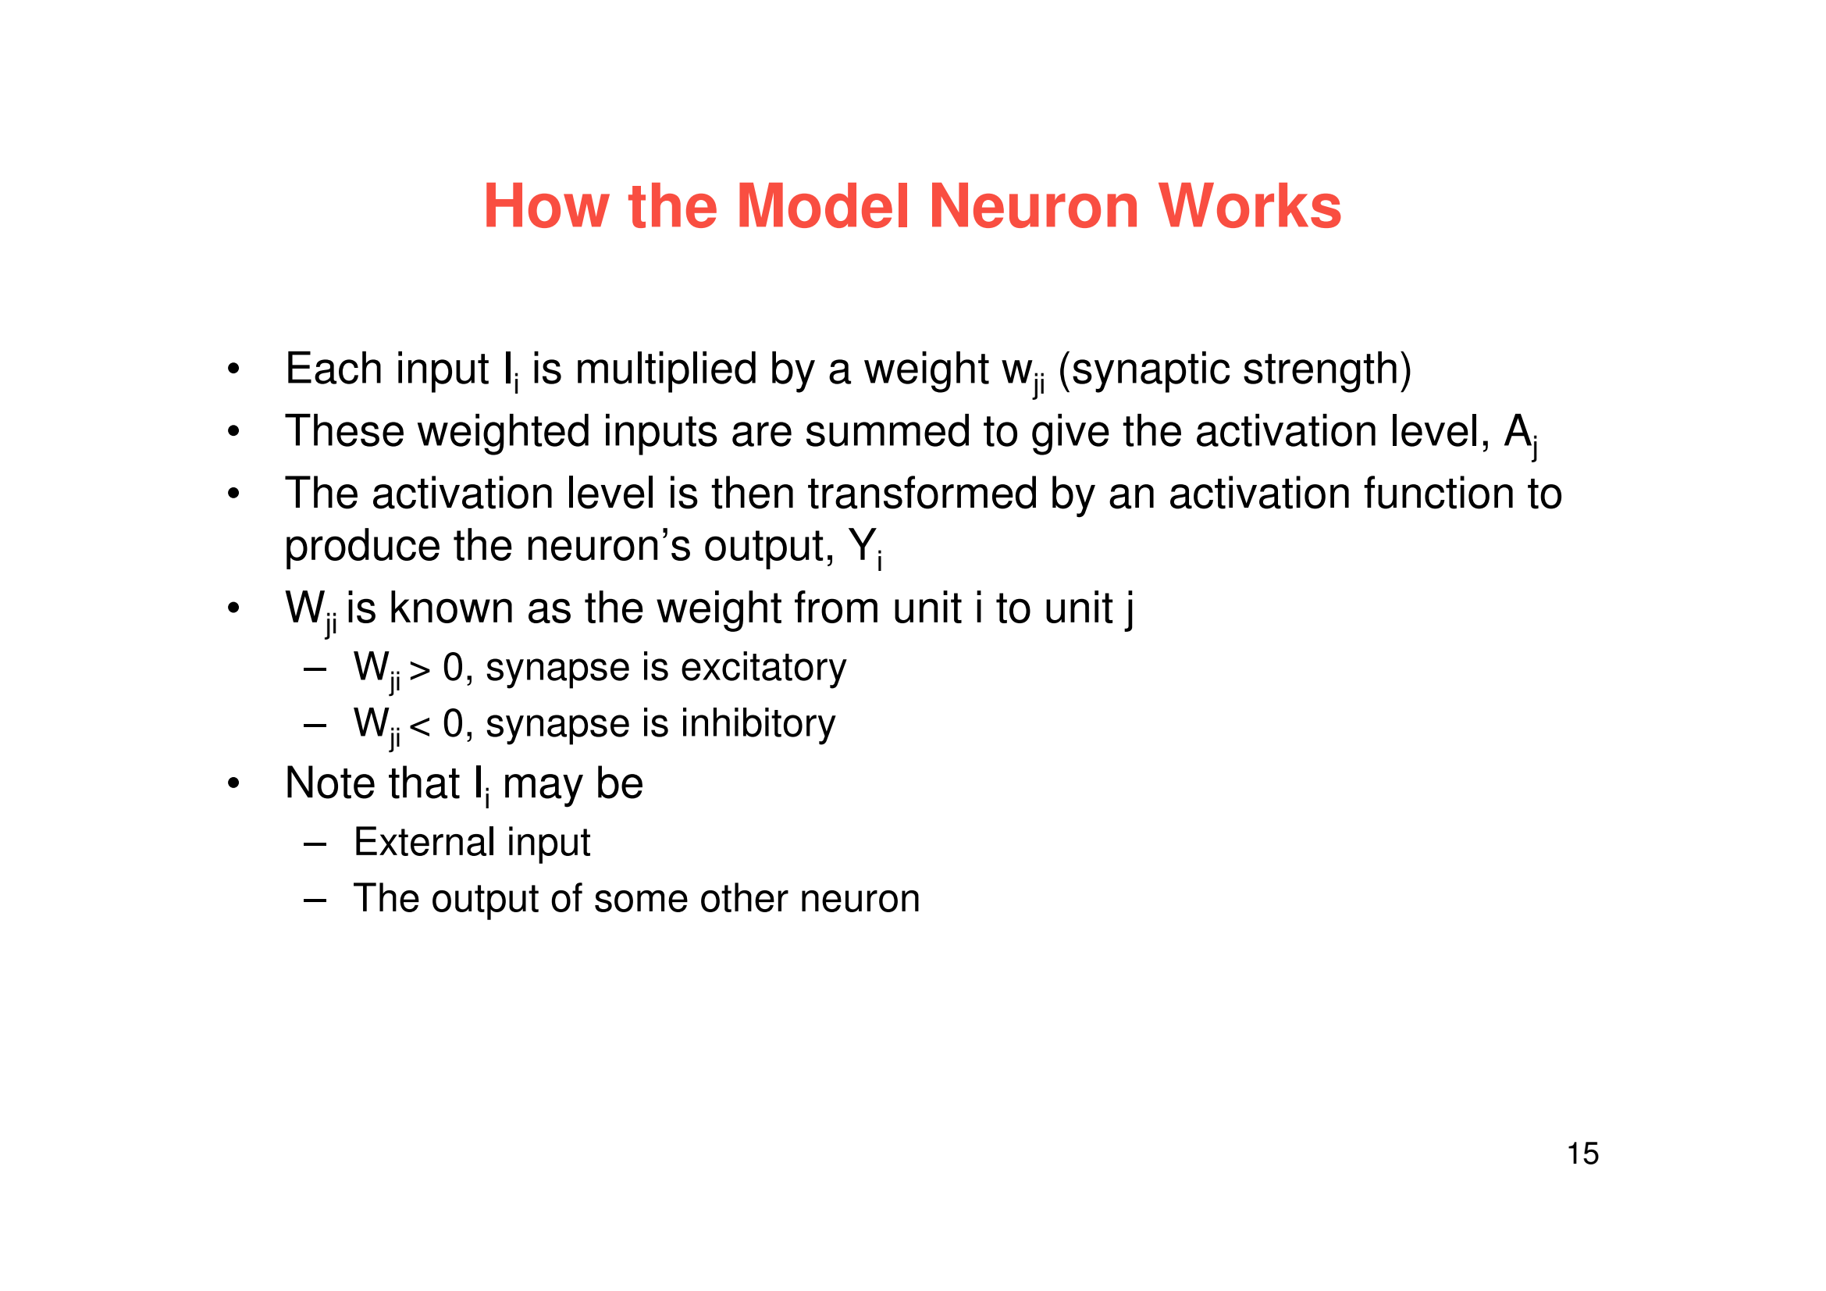
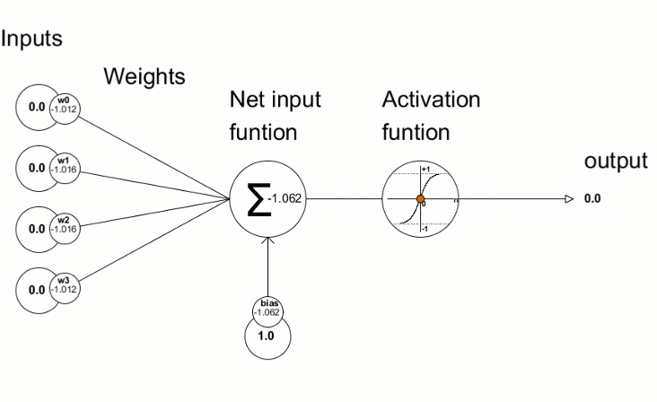
Attendance: https://bit.ly/3Jr5sYu

Slide 20
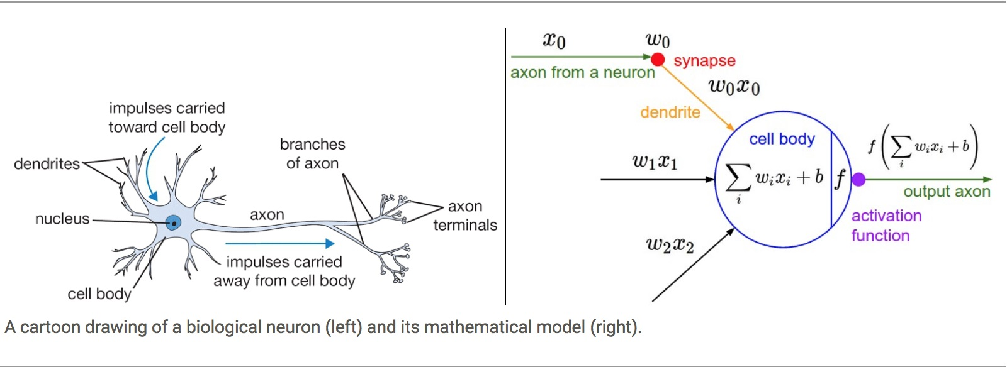
Attendance: https://bit.ly/3Jr5sYu

Slide 21
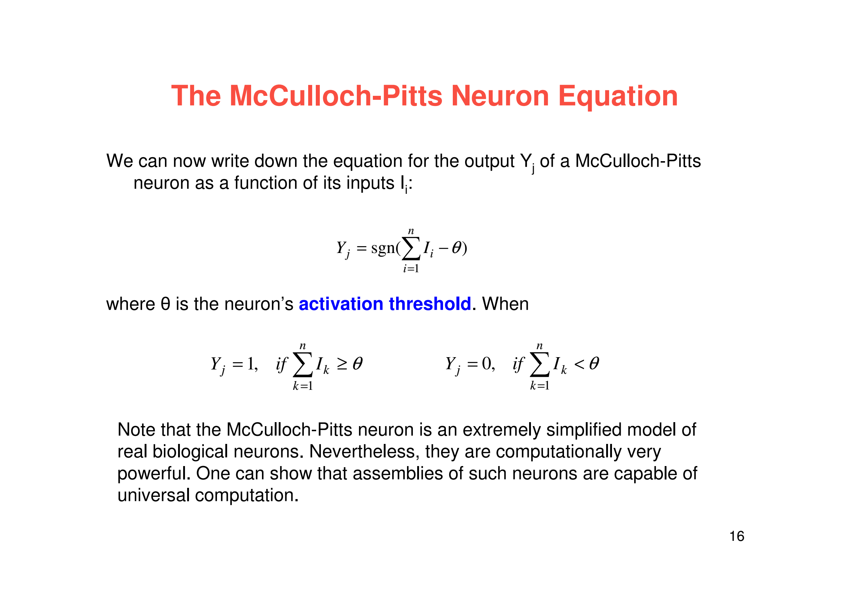
Attendance: https://bit.ly/3Jr5sYu

